Slide 1
Web Design
LIS 488-03 Technology for Information Professionals
Spring 2017, Caryn Anderson

Slide 2
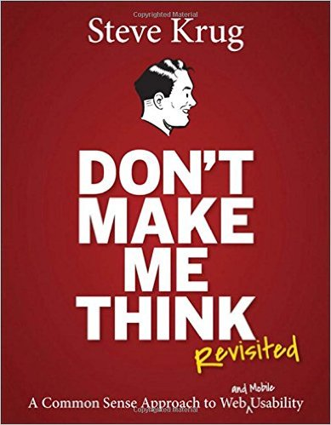
Review Krug: Don’t Make Me Think!
For Web Usability
For Life!

Slide 3
Review Krug: Don’t Make Me Think!
Don’t make me think!
Where am I?
Where is it?
What is it?
Can I click on it?
What happens when I click it?
5. Omit needless words
Happy talk must die
Instructions must die
6. Street signs & breadcrumbs
Department store
Navigation
Scale, direction, location
Conventions
Breadcrumbs & tabs
2. How we really use the web
Scanning vs. Reading
Satisficing
Muddling
7. Big Bang Theory
Big picture
Messaging
Taglines
3. Billboard Design 101
Conventions
Visual hierarchies & areas
Clickable
Noise
Support scanning
8. Farmers & Cowmen
Access limited by user type, IP addy
Remote access, proxy servers
4. Animal, Vegetable, or Mineral?
Who am I?
Stages vs. all at once
Assistance
9. Usability on 10 cents a day
Less users, more often
Stakeholders as observers

Slide 4
Review Krug: Don’t Make Me Think!
10. Mobile
Tradeoffs
Zoom
Direct links
Affordances
Delay
Delight, learnable, memorable
Mobile usability
12. Accessibility
Zoom vs. text size
Fix usability
Read article, book
Low hanging fruit – alt, heading, forms, skip to main content, keyboard, contrast, accessible template
13. Guide for the perplexed
Convincing bosses - ROI, their language, show usability tests
Resist dark forces
At a minimum – type, labels, links, headings
11. Usability as common courtesy
Goodwill – variable
Drains- hiding, punishing, soliciting, shucking & jiving, blocking, amateur
Builds – know, tell, save, effort, answer, comfort, recovery apologize

Slide 5
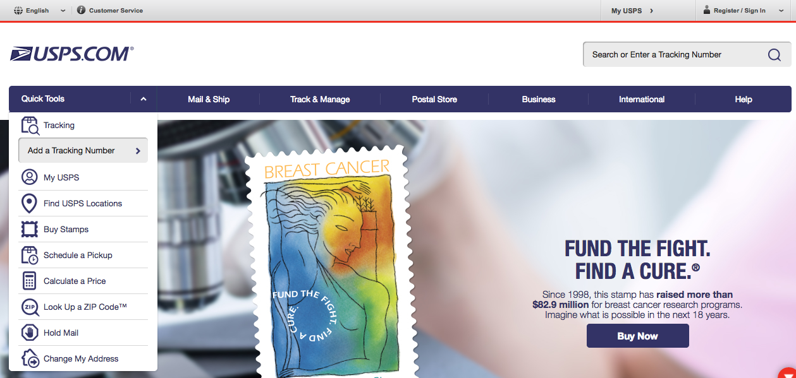
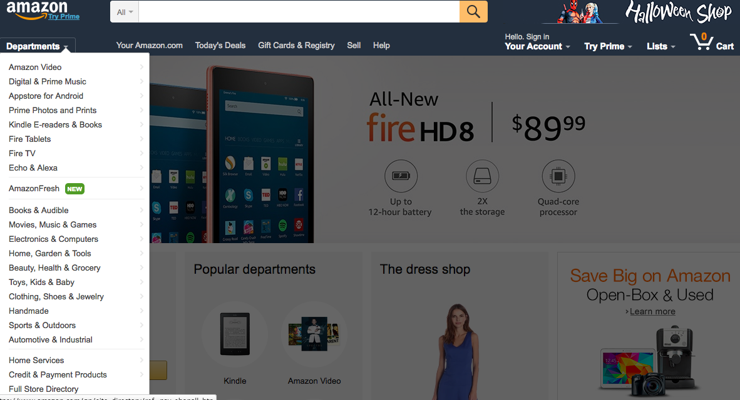
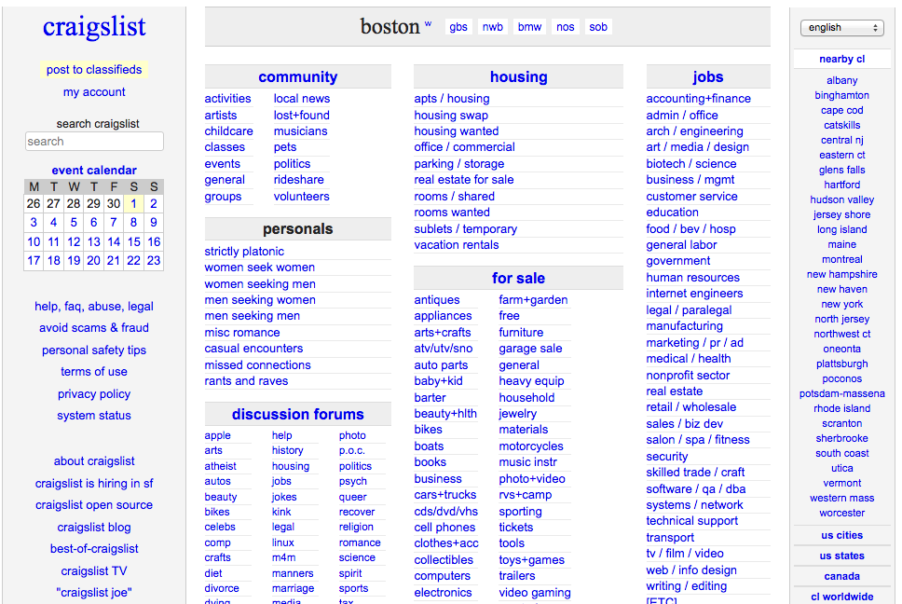
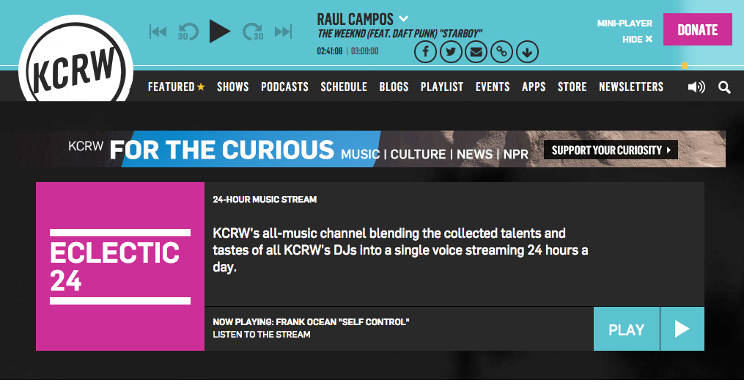
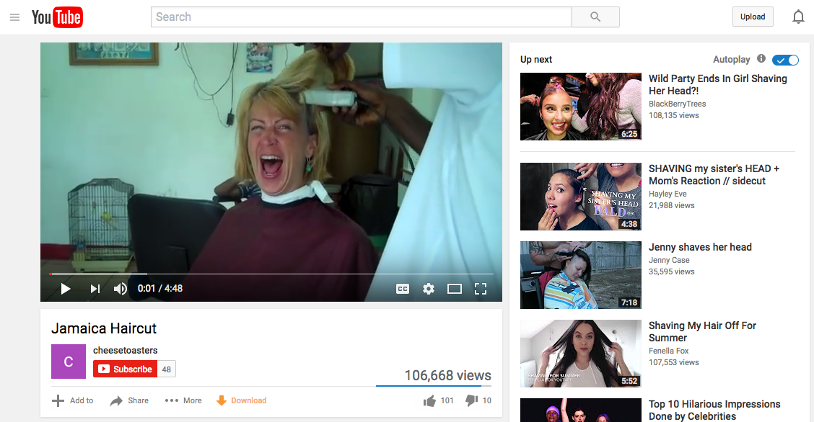
Web Design
Purpose of a website?
Buy stuff
Do stuff
Depends who you are
Listen
Watch
Find

Slide 6
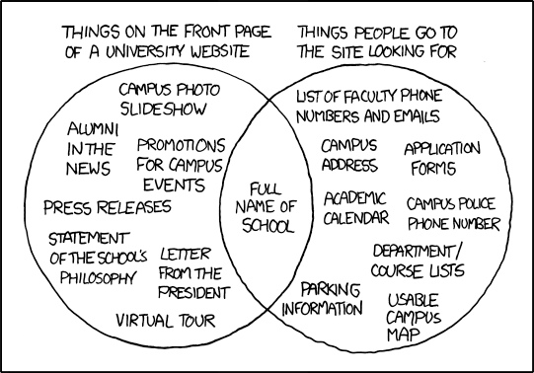
Web Design
https://xkcd.com/773/

Slide 7
Web Design – Without font, color or graphics to distinguish
Usability
Learnable
Effective
Efficient
Card sorting
User personas
Wireframing
Taxonomies
Content modeling
Visibility of system status
Match between system and the real world
User control and freedom
Consistency and standards
Error prevention
Recognition rather than recall
Flexibility and efficiency of use
Aesthetic and minimalist design
Help users recognize, diagnose, and recover from errors
Help and documentation
Useful
Consistent
Simple
Communication
Good error mgt
Minimal workload
Information Architecture
Cognitive load
Mental models
Decision making
Visual design
Choices
Exemplars
Focused navigation
Front doors
Growth
Diverse classification
Disclosure
Objects
Color
Shape
Texture
Space
Form
Typography
Harmony
Balance
Hierarchy
Scale
Dominance
Similarity
Contrast
Organization
Labeling
Navigation
Search

Slide 8
Web Design – with font, color and graphics
USABILITY
Usability
Learnable
Effective
Efficient
Card sorting
User personas
Wireframing
Taxonomies
Content modeling
Visibility of system status
Match between system and the real world
User control and freedom
Consistency and standards
Error prevention
Recognition rather than recall
Flexibility and efficiency of use
Aesthetic and minimalist design
Help users recognize, diagnose, and recover from errors
Help and documentation
Useful
Consistent
Simple
Communication
Good error mgt
Minimal workload
INFORMATION ARCHITECTURE
Information Architecture
Cognitive load
Mental models
Decision making
Visual design
VISUAL DESIGN
Choices
Exemplars
Focused navigation
Front doors
Growth
Diverse classification
Disclosure
Objects
Color
Shape
Texture
Space
Form
Typography
Harmony
Balance
Hierarchy
Scale
Dominance
Similarity
Contrast
Organization
Labeling
Navigation
Search

Slide 9
Web Design – drawing the eye
USABILITY
Learnable
Effective
Efficient
Card sorting
User personas
Wireframing
Taxonomies
Content modeling
Visibility of system status
Match between system and the real world
User control and freedom
Consistency and standards
Error prevention
Recognition rather than recall
Flexibility and efficiency of use
Aesthetic and minimalist design
Help users recognize, diagnose, and recover from errors
Help and documentation
Useful
Consistent
Simple
Communication
Good error mgt
Minimal workload
INFORMATION ARCHITECTURE
Cognitive load
Mental models
Decision making
VISUAL DESIGN
Choices
Exemplars
Focused navigation
Front doors
Growth
Diverse classification
Disclosure
Objects
Color
Shape
Texture
Space
Form
Typography
Harmony
Balance
Hierarchy
Scale
Dominance
Similarity
Contrast
Organization
Labeling
Navigation
Search

Slide 10
Web Design – drawing the eye
USABILITY
Learnable
Efficient
Card sorting
Taxonomies
Content modeling
Visibility of system status
Match between system and the real world
Consistency and standards
Error prevention
Flexibility and efficiency of use
Consistent
Minimal workload
INFORMATION ARCHITECTURE
Mental models
VISUAL DESIGN
Front doors
Diverse classification
Objects
Space
Typography
Harmony
Hierarchy
Dominance
Organization

Slide 11
Web Design – links for more
USABILITY
Learnable
Efficient
Card sorting
Taxonomies
Content modeling
Visibility of system status
Match between system and the real world
Consistency and standards
Error prevention
Flexibility and efficiency of use
Consistent
Minimal workload
INFORMATION ARCHITECTURE
Mental models
VISUAL DESIGN
Front doors
Diverse classification
Objects
Space
Typography
Harmony
Hierarchy
Dominance
Organization

Slide 12
Web Design
USABILITY
Learnable
Effective
Efficient
Visibility of system status
Match between system and the real world
User control and freedom
Consistency and standards
Error prevention
Recognition rather than recall
Flexibility and efficiency of use
Aesthetic and minimalist design
Help users recognize, diagnose, and recover from errors
Help and documentation
Useful
Consistent
Simple
Communication
Good error mgt
Minimal workload

Slide 13
Web Design
So let’s dive in...

Slide 14
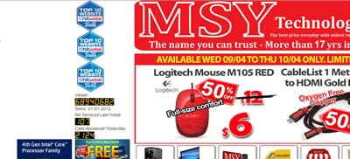
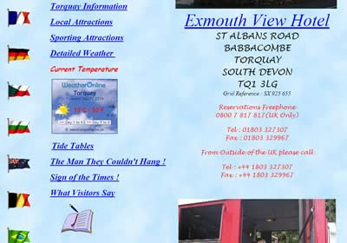
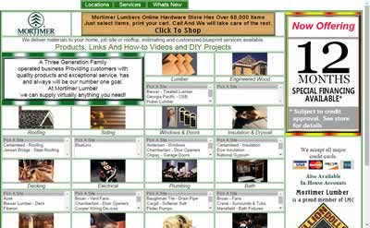
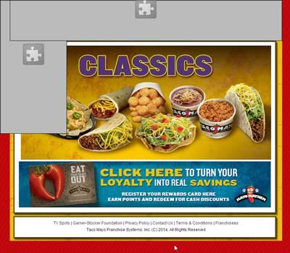
Web Design > Examples of BAD sites
http://www.webpagesthatsuck.com/worst-websites-of-2014.html

Slide 15
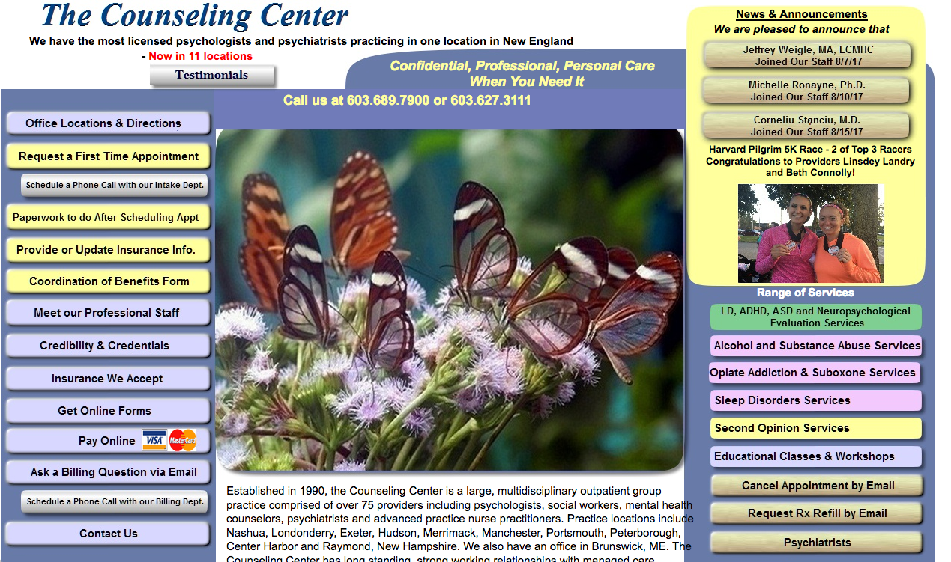
Web Design > Examples of BAD sites
And my personal favorite, discovered by a former 488 student...
If I didn’t need a therapist before I went to this site, I do now!

Slide 16
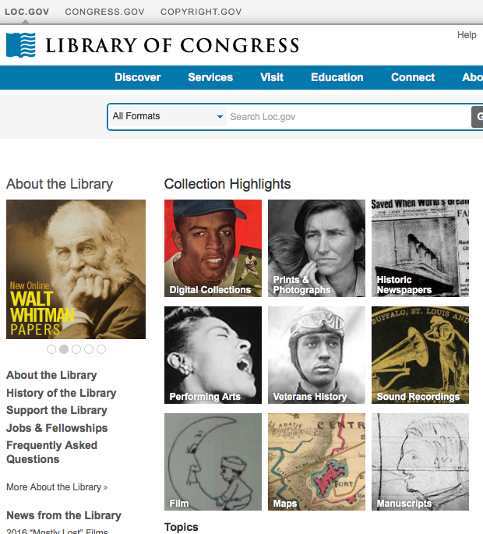
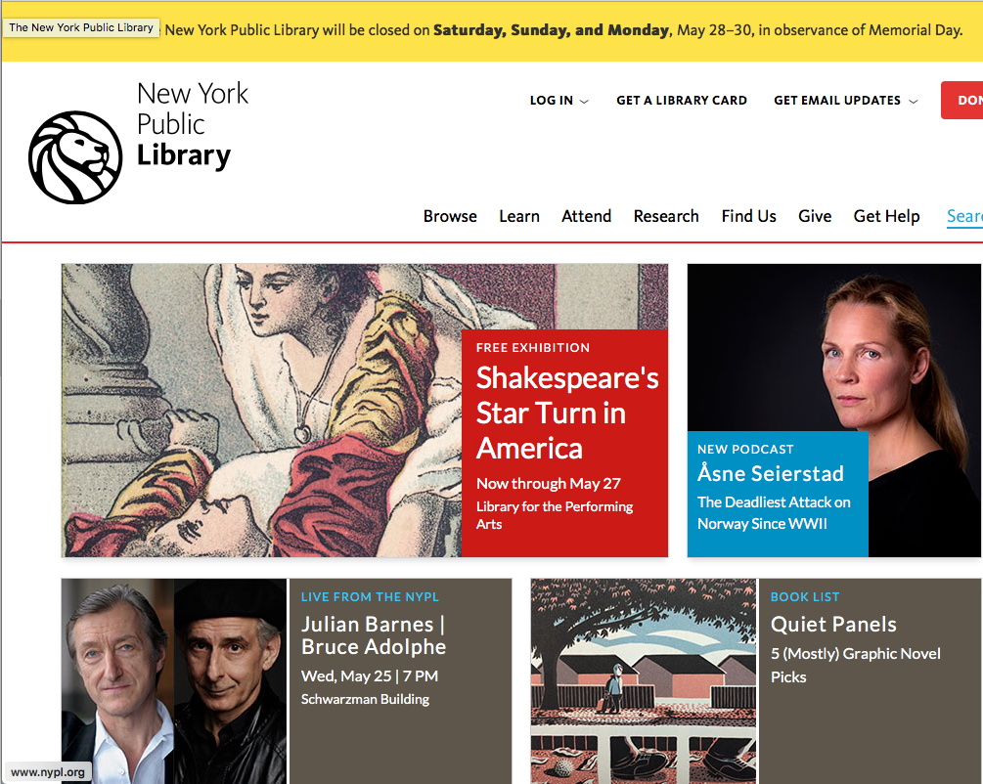
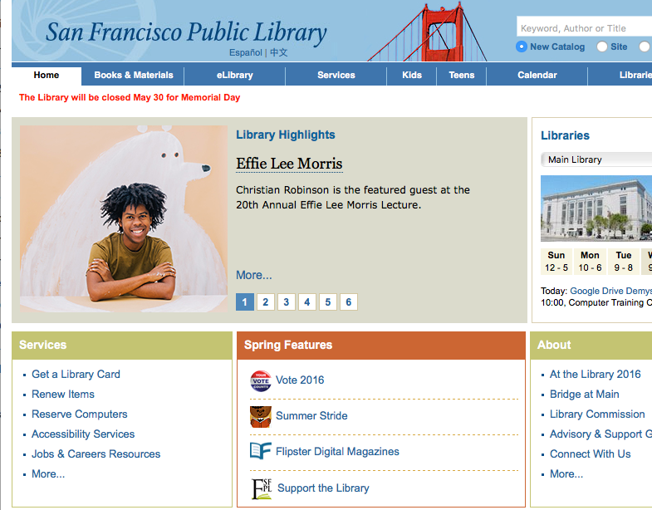
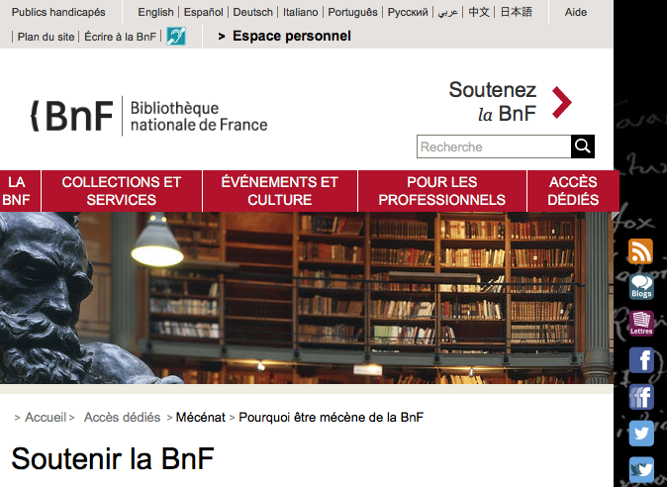
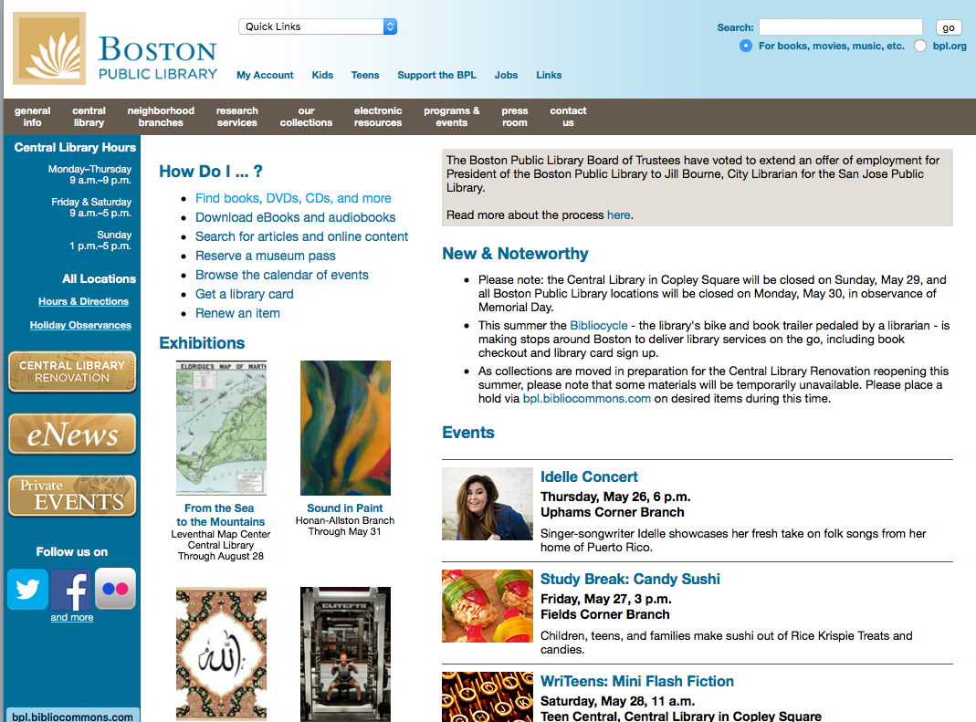
Web Design > Examples (Good/bad? Requires thinking? About what?)

Slide 17
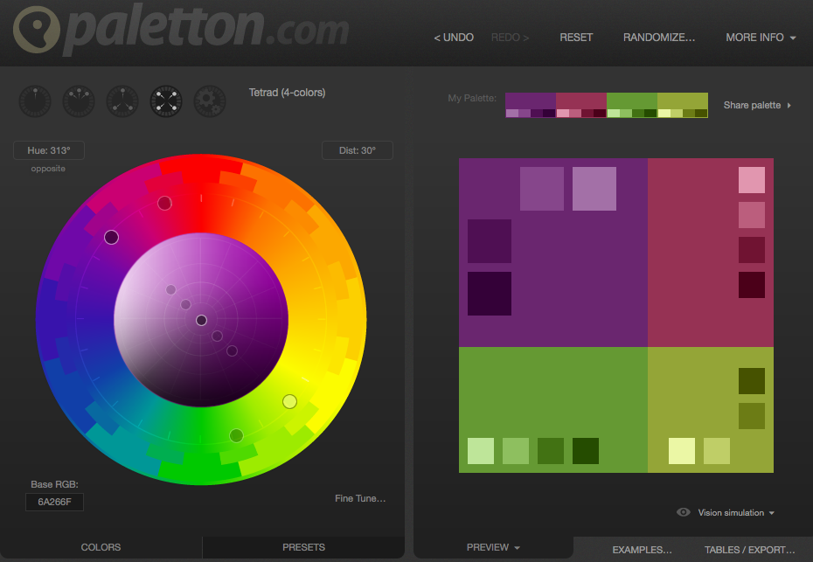
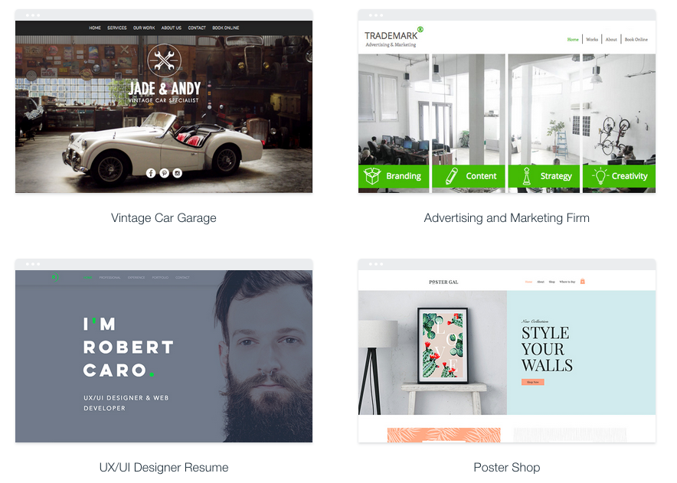
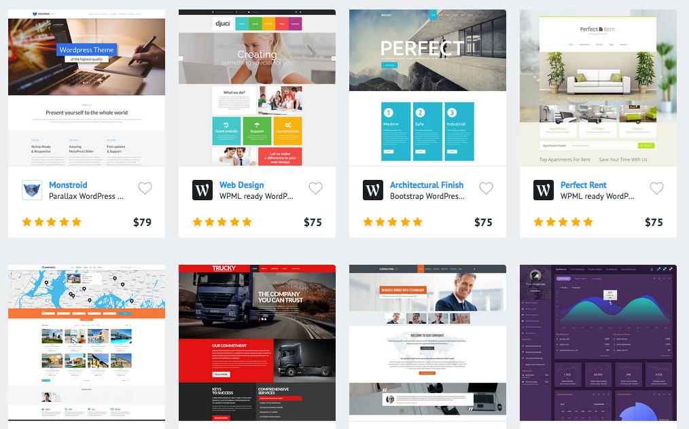
Visual Design > Color
http://paletton.com/
http://colorschemer.com/online.html
https://www.colorcodehex.com
http://www.colorhexa.com/web-safe-colors
Be aware of Color models in computing [rgb, rgba, cymk, hsl]
Representations of color: hex, color names
VISUAL DESIGN
Color
Shape
Texture
Space
Form
Typography
Harmony
Balance
Hierarchy
Scale
Dominance
Similarity
Contrast

Slide 18
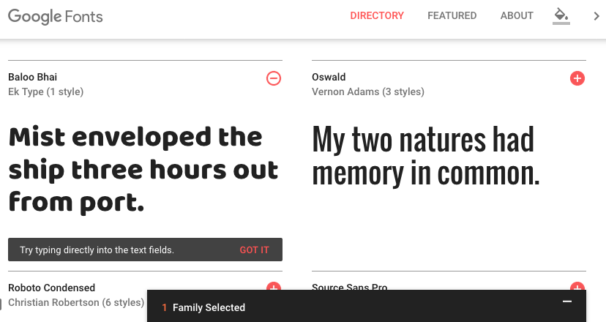
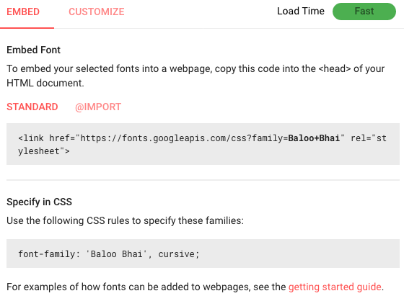
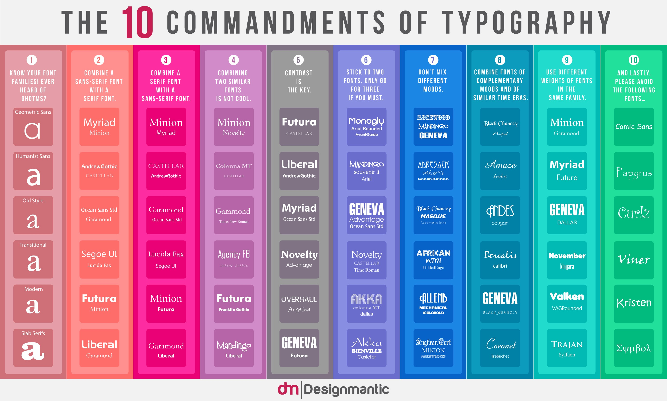
Visual Design > Typography
https://fonts.google.com/
http://webitect.net/design/the-top-10-typography-rules-all-in-one-place/
http://typophile.com/files/typography_rules.pdf
Fonts live in font files (.ttf, .otf, .svg, .woof, .ps)
Fonts are scalable vector graphics that paint the image of the letter on the screen

Slide 19
Visual Design > Composition
header: menus, branding
header: menus, branding
Composition
Rule of 3
Most
common
content area
content area
Side
Menu
footer: navigation; copyright
footer: navigation; copyright

Slide 20
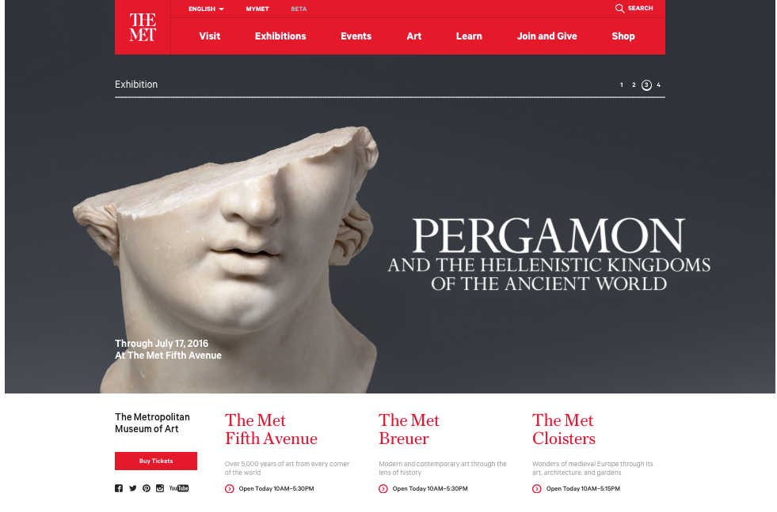
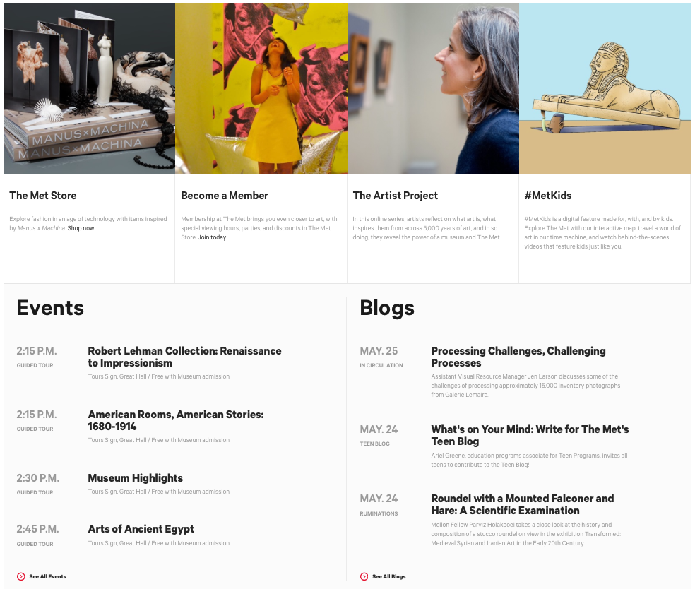
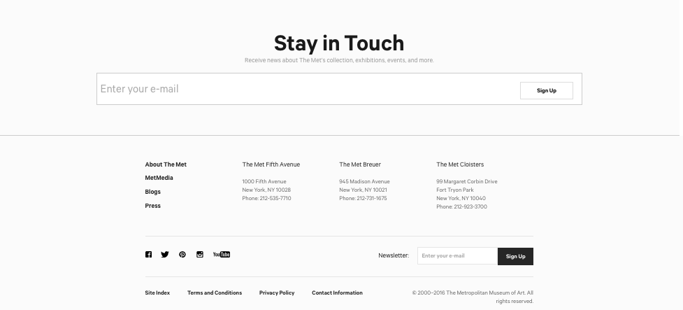
Visual Design > Composition
Metropolitan Museum of Art …
Divides the site into 3 chunks …
and then each chunk subject to more containers…
Top: Advertising and Dynamism to attract folk
Moving images of exhibits and events …
and shopping!
“Stay in Touch” - combines legal, digital rights management with advertising

Slide 21
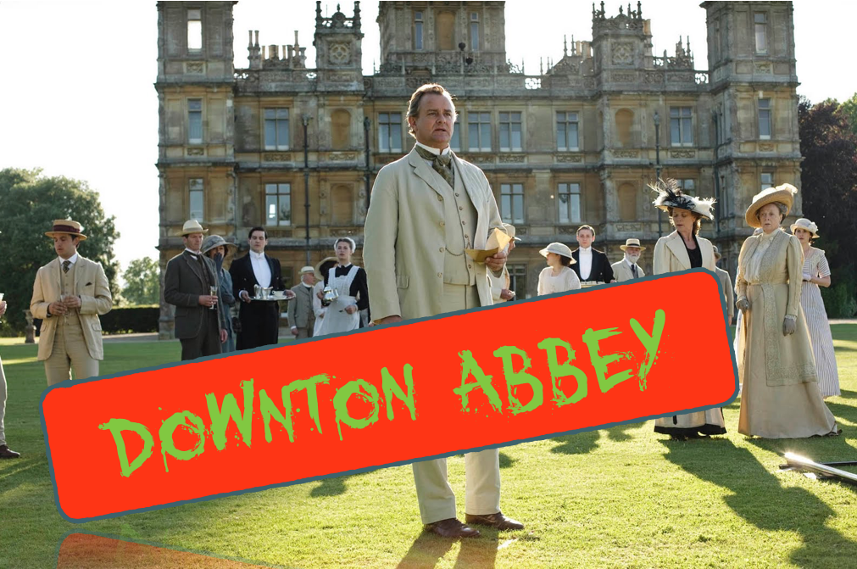
Visual Design
Finally... fonts, colors, and composition should always be appropriate to the content...

Slide 22
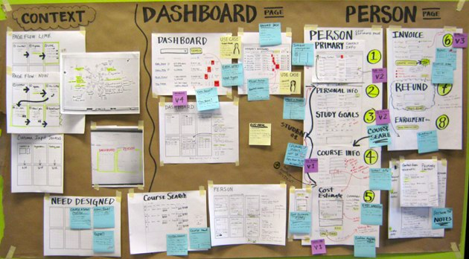
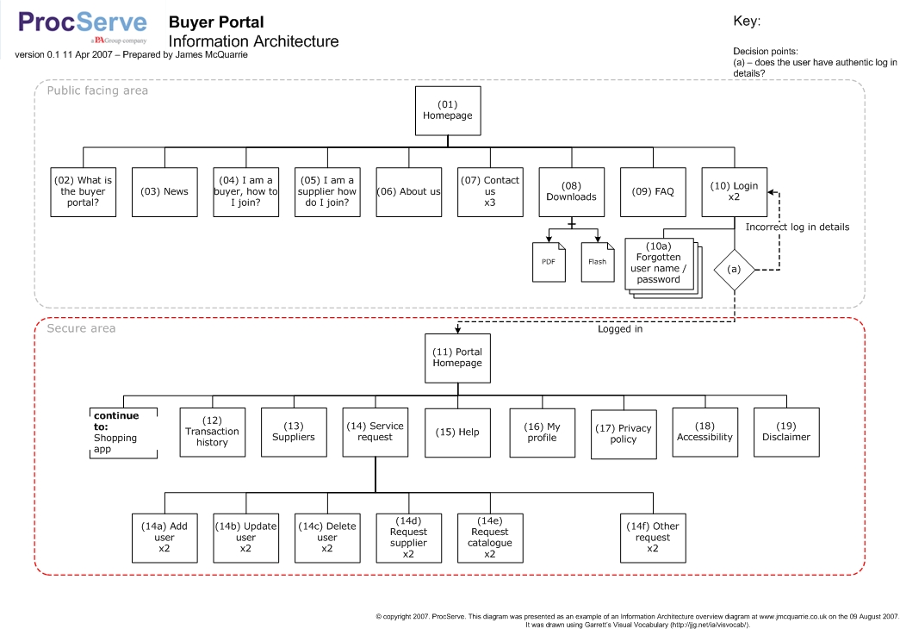
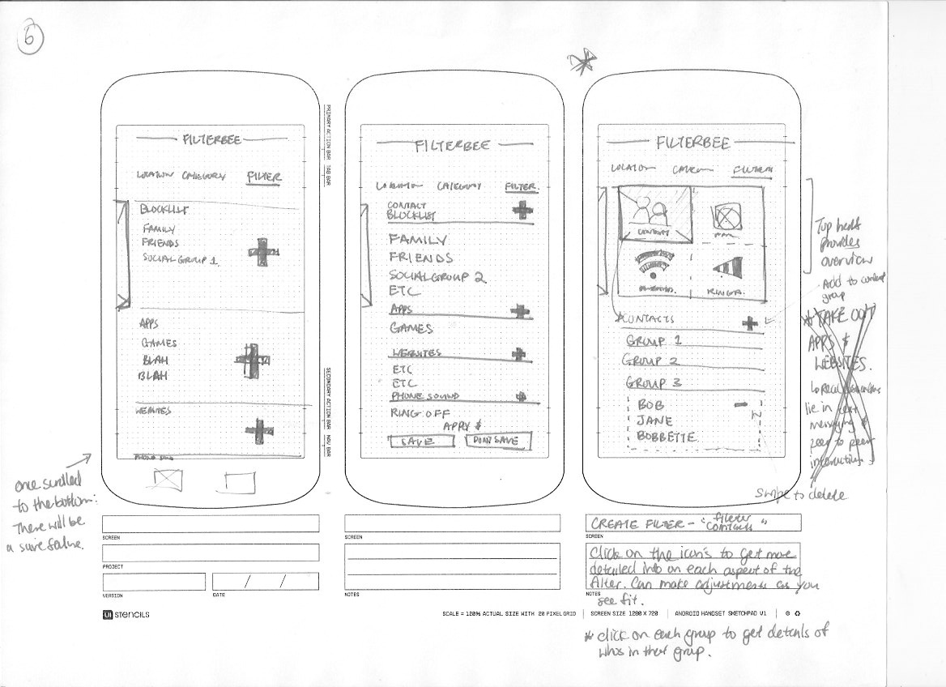
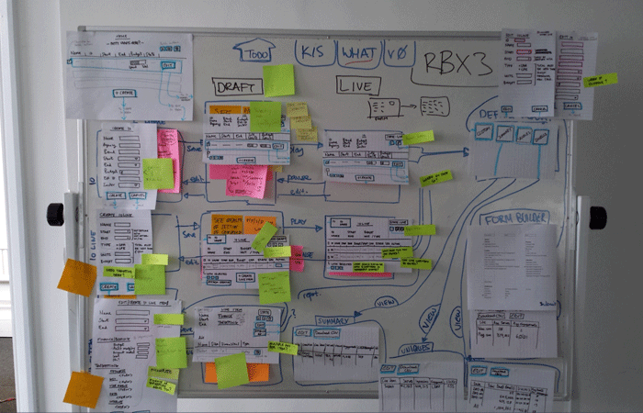
Information Architecture
Card sorting
User personas
Wireframing
Taxonomies
Content modeling
INFORMATION ARCHITECTURE
Cognitive load
Mental models
Decision making
Choices
Exemplars
Focused navigation
Front doors
Growth
Diverse classification
Disclosure
Objects
Organization
Labeling
Navigation
Search

Slide 23
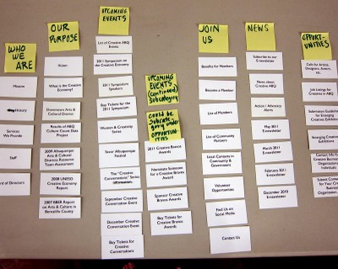
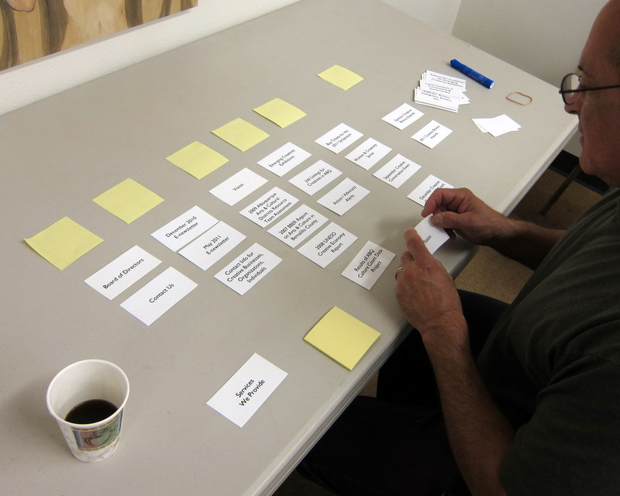
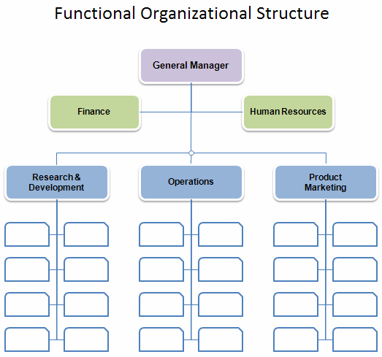
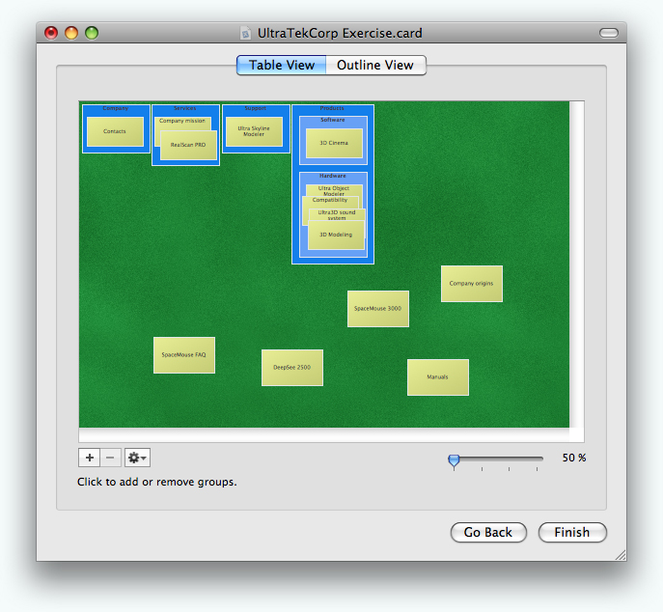
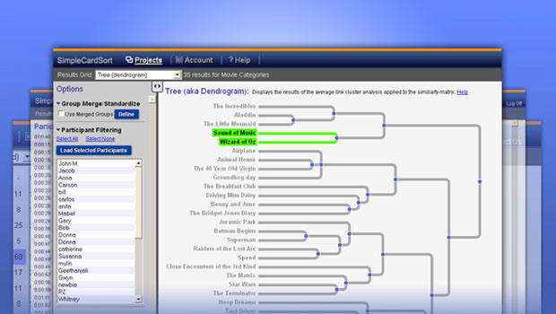
Organization > Card Sorting
They will NOT organize your site like your org chart!
Get as many different types of users to sort your content as possible
Be sure to keep track of which types of users group content in which ways
Or use software, which will analyze the results for you (e.g., xSort)
Let them name or re-name content or groups!

Slide 24
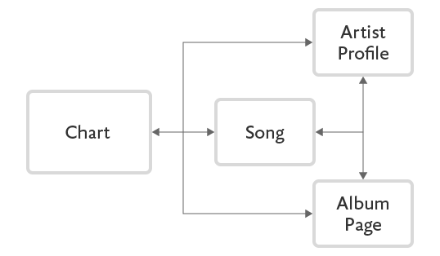
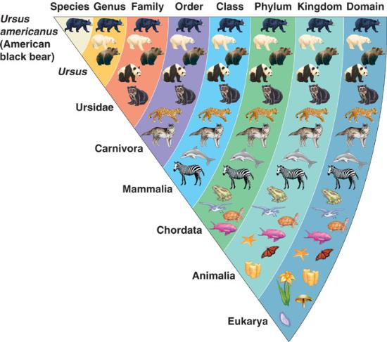
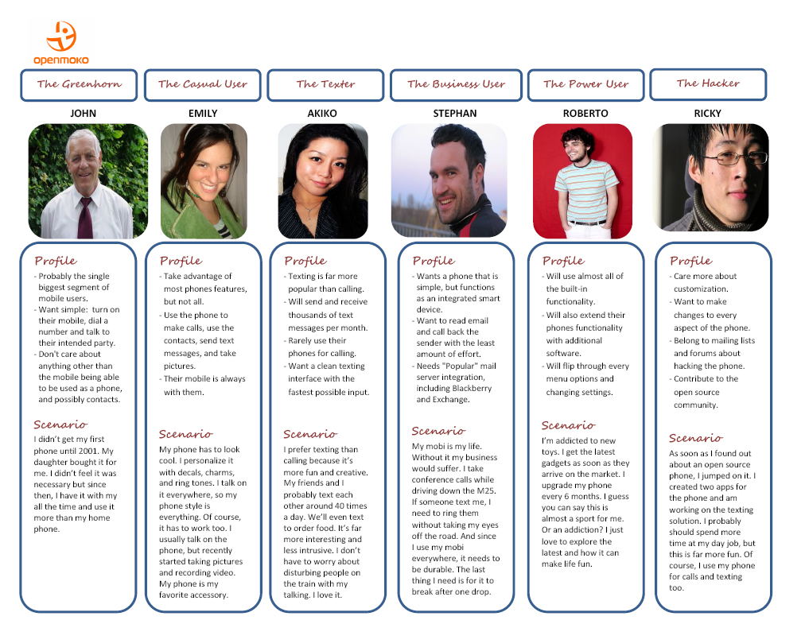
Organization > Planning Tools/Methods
http://alistapart.com/article/content-modelling-a-master-skill
Taxonomies
the system needs logic
Content Models
the system needs to account for relationships between types of content
User Personas
the system needs to match how real users are going to use the site

Slide 25
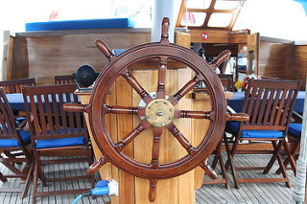
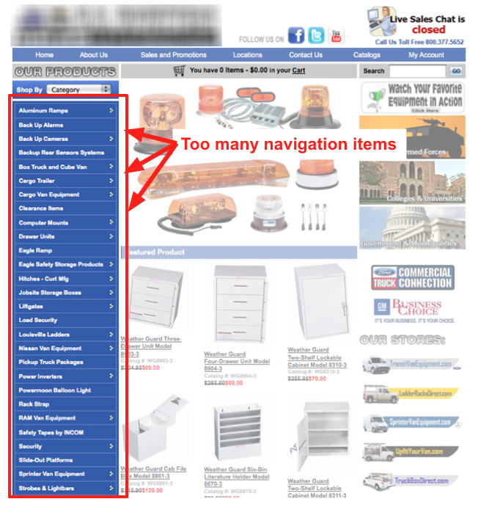
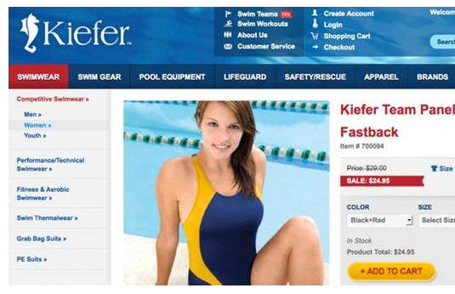
Navigation
Do
Don’t
Use descriptive labels
Put it in standard places (top and left)
Put most important items first (or last)
Keep labels brief
Provide alternatives if possible
Be consistent!
Use generic labels
Put it in the middle of the page
Use dropdowns without testing
Be careless about order
Have too many items
Have long labels that wrap lines
Be inconsistent!
Object-based
Action-based
Audience-based
Search Engine optimized
Hierarchical
Global
Local
Important stuff first, descriptive labels
Bars
Tabs
Breadcrumbs
Sitemaps
Dropdowns/Flyouts
Sub-nav by audience type, or style

Slide 26
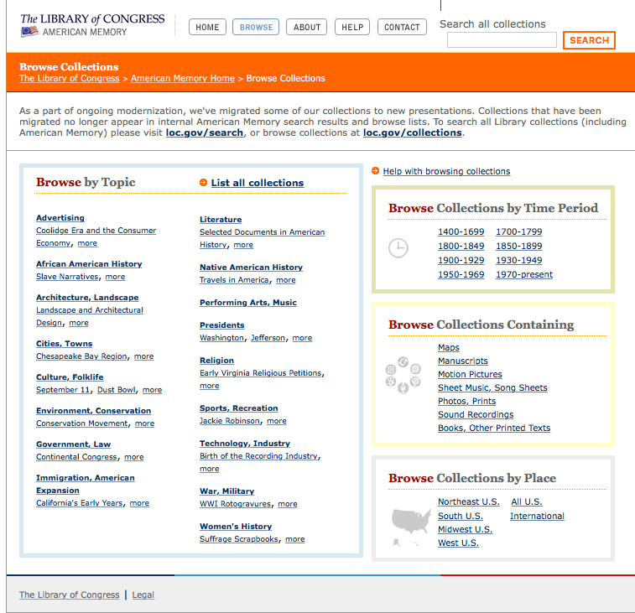
Information Architecture
Are you sure your system will search all the places your user thinks it will?
Are you sure your user will use the same words you do to describe the content they are looking for or action they want to take?
If not, you’d better have a way for them to browse...
...and it probably needs to be more than your navigation

Slide 27
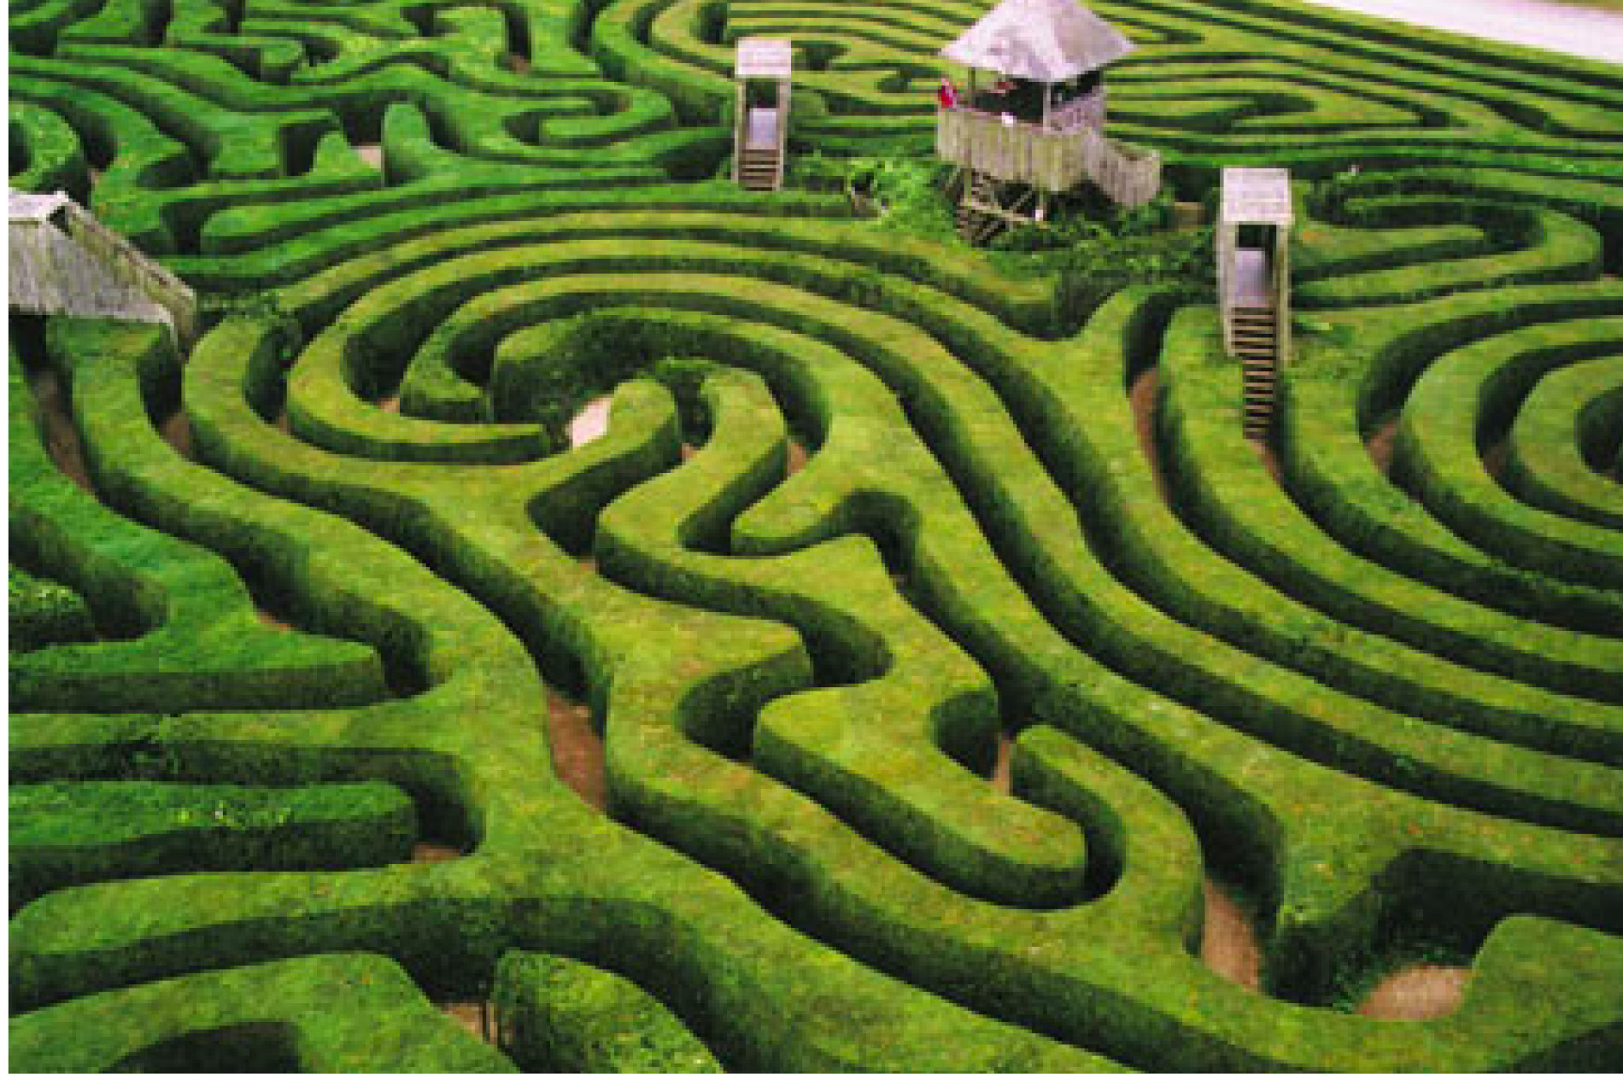
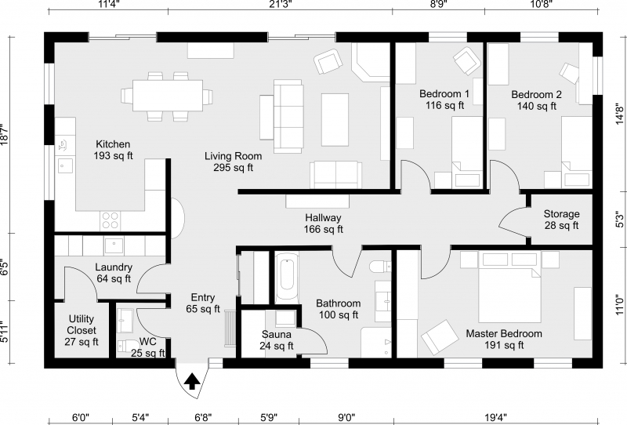
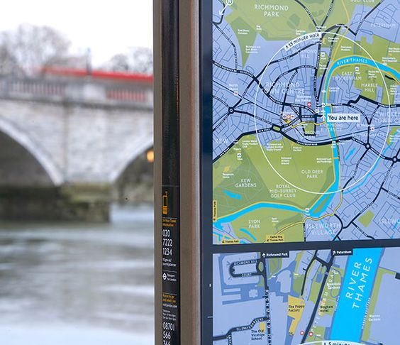
Information Architecture
Do your users need this?
Is this you?
Or nothing at all?
Or is this you?

Slide 28
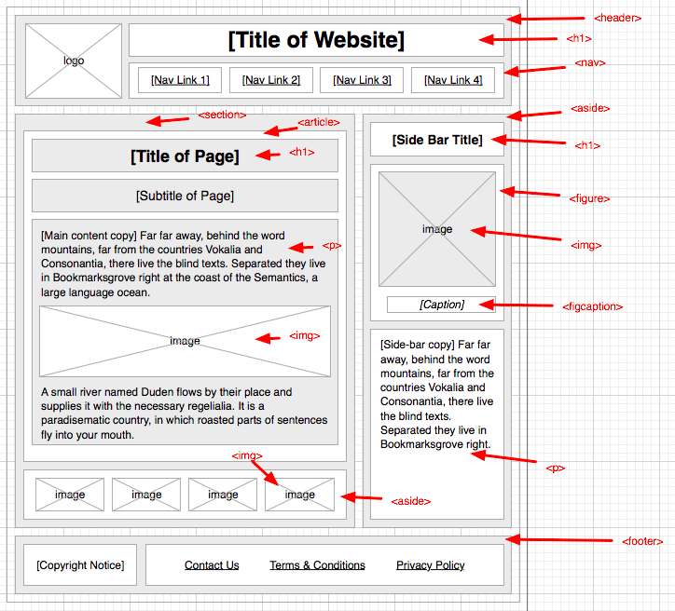
Information Architecture

Slide 29
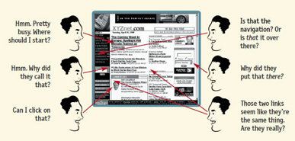
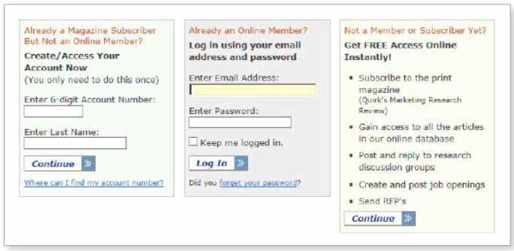
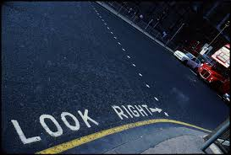
Web Design
USABILITY
Learnable
Effective
Efficient
Visibility of system status
Match between system and the real world
User control and freedom
Consistency and standards
Error prevention
Recognition rather than recall
Flexibility and efficiency of use
Aesthetic and minimalist design
Help users recognize, diagnose, and recover from errors
Help and documentation
Useful
Consistent
Simple
Communication
Good error mgt
Minimal workload

Slide 30
Web Design – Usability
Does it parallel the physical space?
Do I know what’s happening?
Can I do what I want?
Does it keep me from making mistakes?
Do I know where to go for assistance?
User Experience Design
Do I have to remember stuff?
Can I figure out when I’ve done something wrong?
Is it attractive?
Can I do things quickly and in different ways?
Does it feel familiar?

Slide 31
Web Design – Usability
USABILITY
Tools of usability
Allow user to say “Yes” (not think)
Visibility of system status
Match between system and the real world
User control and freedom
Consistency and standards
Error prevention
Recognition rather than recall
Flexibility and efficiency of use
Aesthetic and minimalist design
Help users recognize, diagnose, and recover from errors
Help and documentation
Do I know what’s happening?
Does it parallel the physical space?
Can I do what I want?
Does it feel familiar?
Does it keep me from making mistakes
Do I have to remember stuff?
Can I do things quickly and in different ways?
Is it attractive?
Can I figure out when I’ve done something wrong?
Do I know where to go for assistance?

Slide 32
Web Design
Do I know what’s happening?
Does it parallel the real world?

Slide 33
Web Design
Do I know where to go for assistance?
Does it feel familiar?
Can I do what I want?
(search, browse)
Do I have to remember stuff? (like where I am?)
Can I do things quickly and in different ways?

Slide 34
Web Design
Let’s analyze some home pages...

Slide 35
Web Design

Slide 36
Web Design

Slide 37
Web Design References
Strongly recommend the online Web Style Guide
http://webstyleguide.com/wsg3/index.html
https://www.usability.gov/
https://www.branded3.com/blog/top-10-worst-websites/
http://www.webpagesthatsuck.com/worst-websites-of-2014.html
http://100bestwebsites.org
http://www.mattanderson.org/blog/2013/02/11/20-great-public-library-websites/
http://www.ala.org/offices/library/alarecommends/recommendedwebsites

Slide 38
So, you won’t make me think, right?
Questions?

